Slide 1

GNOD
Enhancements

Slide 2
Introduction
This project is focused on developing a music recommendation system that suggests songs to users based on their preferences and listening habits
The system aims to personalize music recommendations by analyzing user behavior, song attributes and provide suggestions to the users on the trending music around the world.

Slide 3
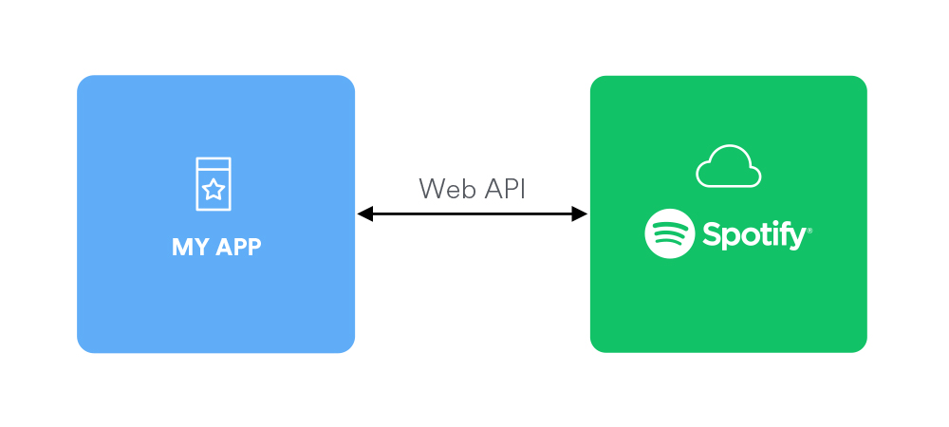
Data Collection
The music recommendation system utilizes the Spotipy API to gather song and user interaction data from Spotify.
Key Features Collected :
Song Metadata: Title, artist.
Audio Features: Tempo, danceability, energy, mood, and other acoustic properties.

Slide 4
Methodology
Data Collection & Web Scraping: Spotipy API and web scraping techniques were used to gather song metadata, audio features, and user data from Spotify.
Data Cleaning & Visualization:Pandas and NumPy were used for data cleaning, while Matplotlib and Seaborn visualized trends in user behavior and song attributes.
Clustering Algorithms Used:K-Means and DBSCAN clustering algorithms were applied to group similar songs and users, enabling personalized recommendations.
Interactive Web Interface:An interactive Streamlit web app was created to display real-time song recommendations based on user preferences.

Slide 5

Exploratory Data Analysis

Slide 6
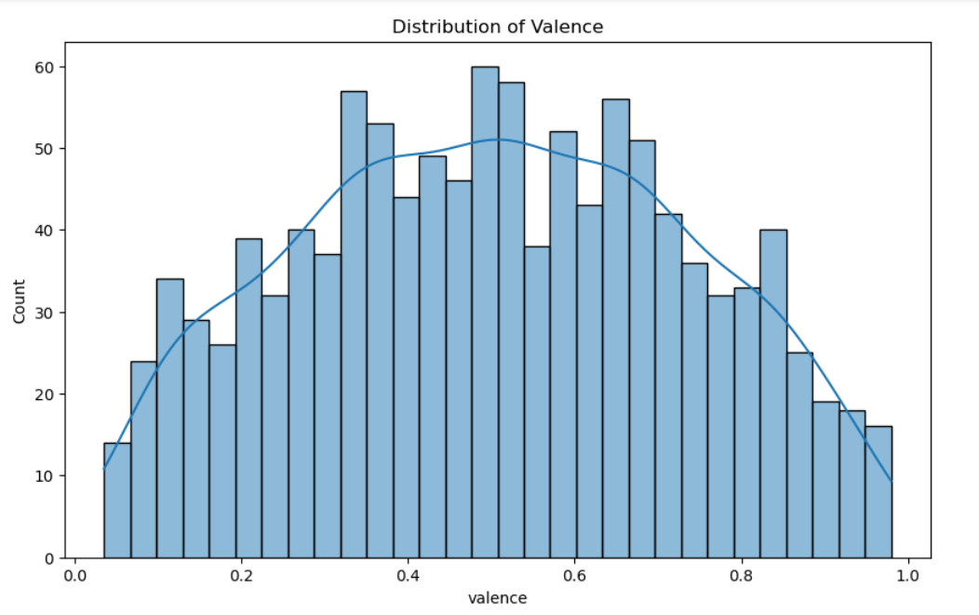
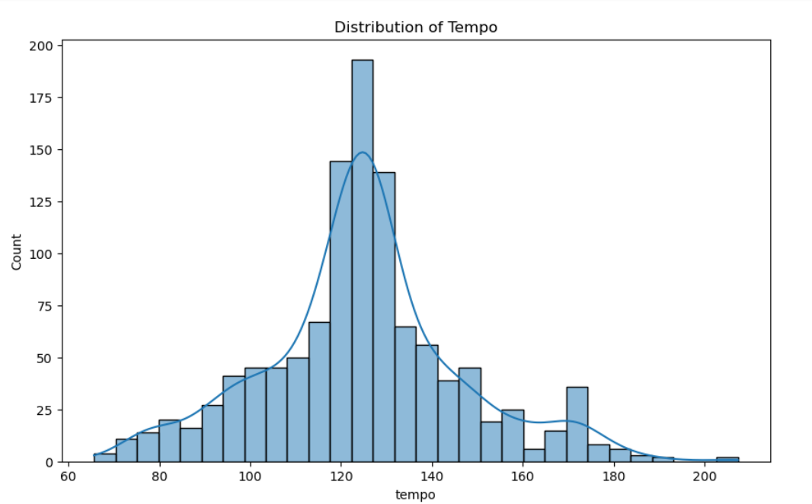
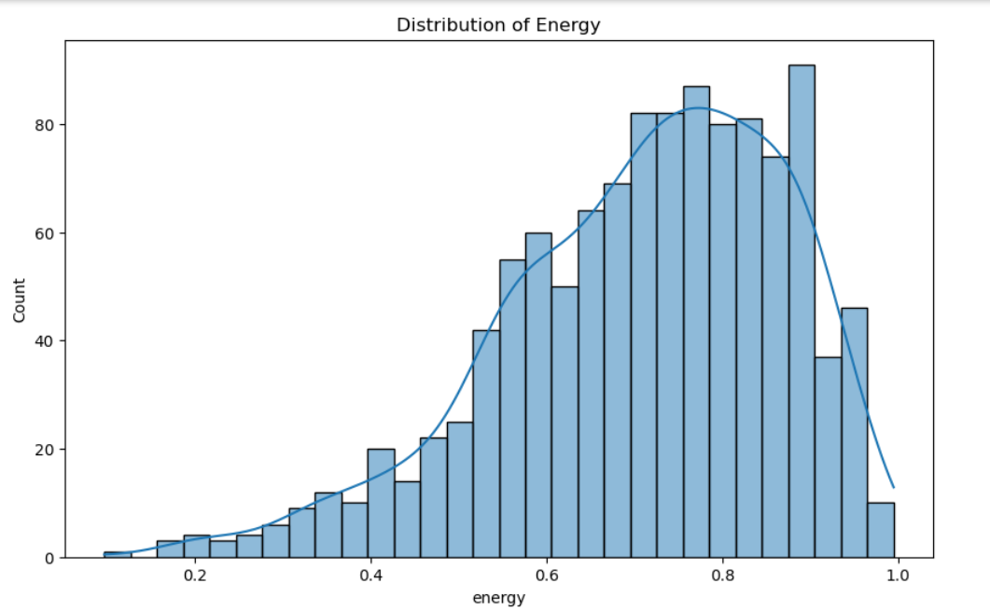
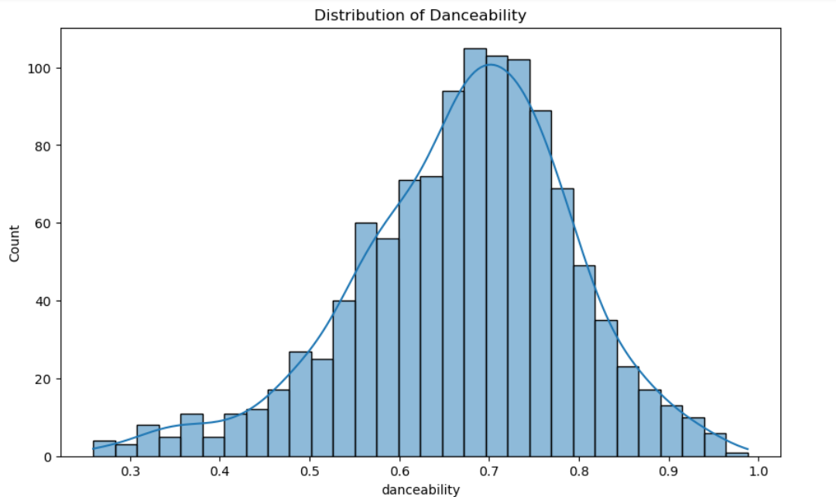
Distribution of Song Features
This histogram visualizes the distribution of key song features like danceability, energy, and other acoustic properties across the dataset.
The distribution shows the variation in song characteristics, helping identify patterns in song selection and preferences for different genres or user profiles

Slide 7
K-Means Clustering for Song Grouping
Overview of K-Means Clustering:
K-Means is an unsupervised machine learning algorithm used to group songs into K clusters based on their similarity, allowing for personalized recommendations.
Feature Selection for Clustering:
We used song features like danceability, energy, tempo, and valence to form clusters that group songs with similar acoustic characteristics.

Slide 8
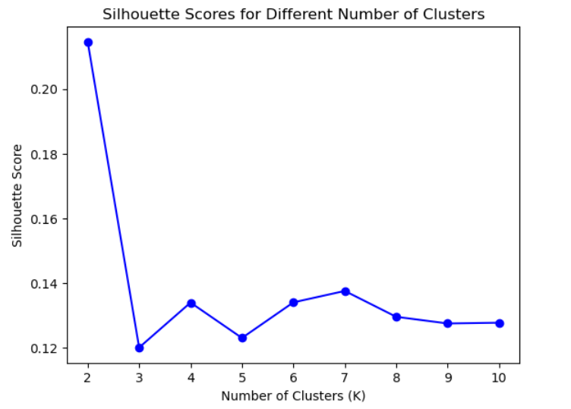
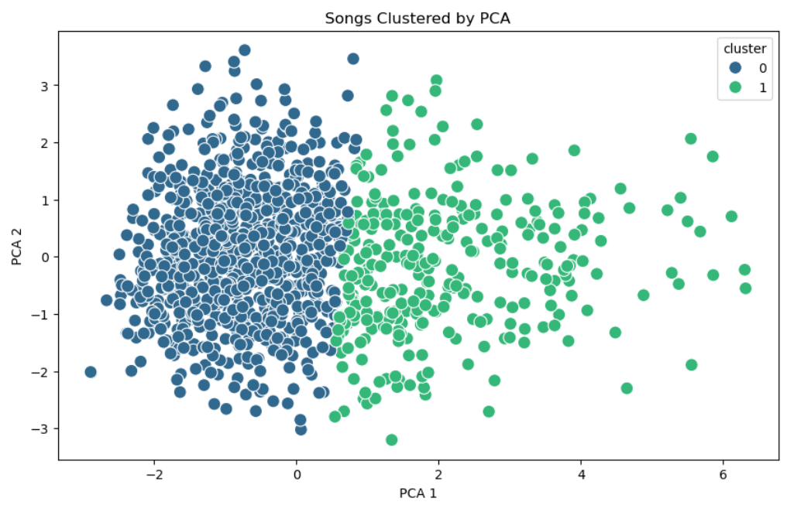
Visualizing the Silhoutte Scores and Clusters
Cluster Representation:
The clusters are visualized using a scatter plot, where each point represents a song and is coloured according to its cluster
Feature-Based Grouping:
Songs are grouped based on key features like danceability and energy, showing clear patterns in how similar songs are clustered together

Slide 9
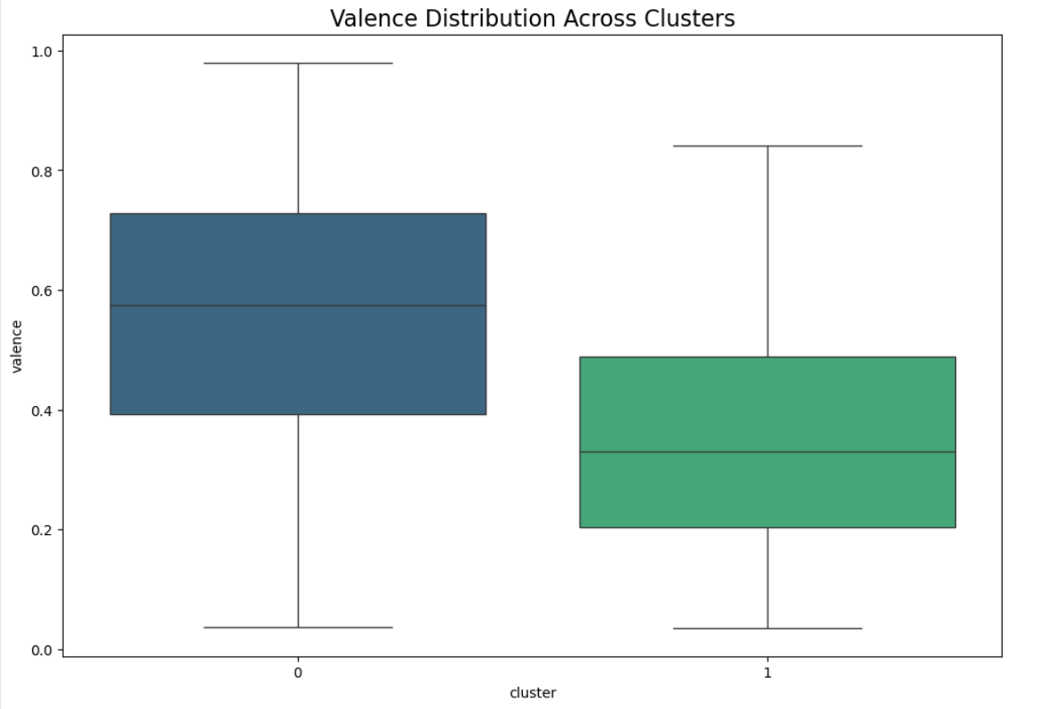
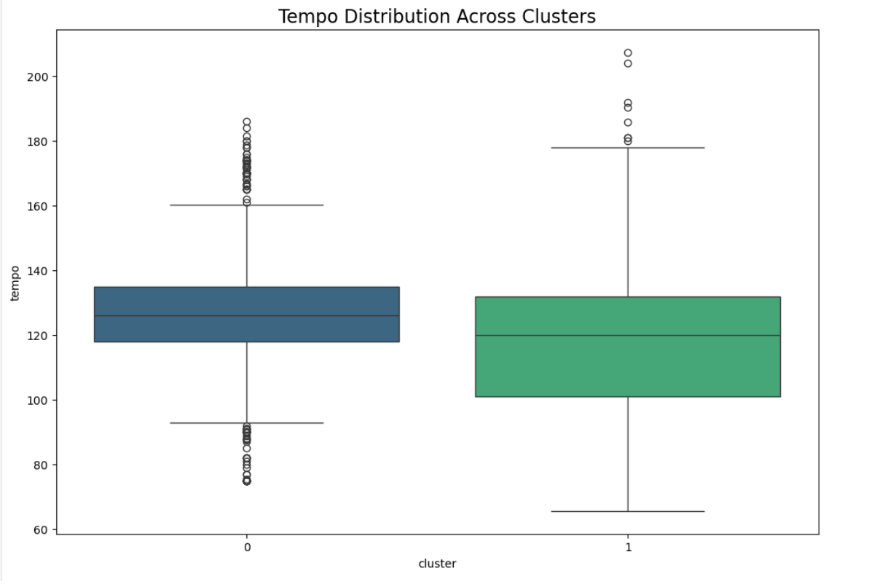
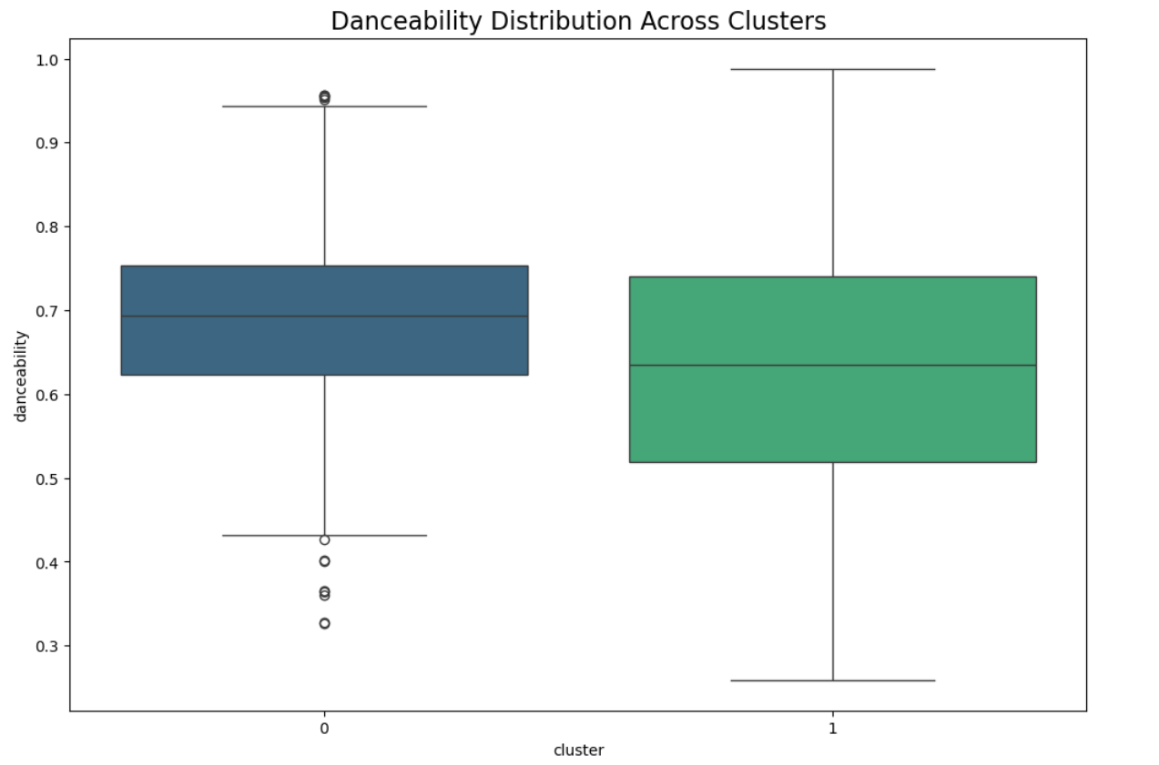
Feature Distribution Across Clusters
This chart shows how song features like danceability, valence and tempo vary within each cluster, highlighting unique characteristics of each group.

Slide 10
Streamlit

Slide 11

Future Work
Enhanced Model Accuracy:
Incorporate more advanced algorithms, such as deep learning, to improve recommendation precision
Additional Audio Features:
Expand the model by integrating more song features like lyrics analysis or mood detection

Slide 12
Conclusion
With further improvements, this system has the potential to deepen user engagement and music discovery through advanced personalization.
By leveraging clustering and user data, this project demonstrates the power of data-driven recommendations in modern music streaming.

Slide 13
Thank you
By:
Supriya Arunkumar

